Slide 1

Instructor Notes
Ensure you update your contact information on the Title slide
This class is a combination of Lecture, Demo and Lab
All Demos and Labs are described in the slide Notes.
Open File Power BI Adv DataViz_Complete_Mar2018 for use during Demos.
SETUP:To Demo the R Custom Visual, ensure you have R installed (get it here)
Then Download the Custom R Visual “Forecasting” and ensure you can run the sample package (it will install the necessary packages). If you have problems, just speak to the chart, rather then demo
If you have taught this class previously, grab the two pbix files out of the USB folder to start with fresh files free from any changes you might have made.
Download and install Power BI Desktop:
Download and install Microsoft Power BI Desktop from: http://www.microsoft.com/en-us/download/details.aspx?id=45331
URLS:
Hans Video queued and ready (test your sound with the AV person)
Color Brewer – Cynthia Brewers Color Brewer
https://color.adobe.com/create/color-wheel/
Paletton.com
Symbols: unicode-table.com
Custom Visuals website - visuals.powerbi.com
Power BI Service website - app.powerbi.com
How Microsoft Uses PowerBI Blog
Theme Generator - this automatic theme generator
Contrast Analyzer - https://developer.paciellogroup.com/resources/contrastanalyser/
September Update: Discussion of Drill Path
Version: Mar2018

Slide 2
Hobbs
Digital Insights Consultant
jhobbs@valorem.com
Notes:
Take out survey link if this class is being taught external to Microsoft.
Change Log:
Add Miranda’s suggestions.
-Slide 29 change the slide name
- Readjust the order of slide 38 to 42
-Slide 78 change the icon

Slide 3
Agenda
What is Story Telling with Data
Science Behind Data Visualization
Process Behind Data Visualization
Dashboards and Reports
Chart Selection
Custom Visuals
Polishing & Formatting
Notes:
The class is roughly 4 hours

Slide 4
COURSE OBJECTIVES
By the end of this course, you gain a better understanding of Storytelling with Data. Specifically you will be able to:
Understand the need for storytelling with data
Understand the agile process to creating Power BI data visualizations
Understand the art behind visualizations
Gain familiarity with Power BI report layouts and structure
Understand implications behind choosing the right charts
Gain familiarity over the use of Power BI custom visuals
Notes:
Talk to the slide
Why do you need to tell a story with data, how to think agilely.

Slide 5
What is Story Telling with Data

Slide 6

Today’s world is filled with Data
What is Story Telling with Data
Volume
Velocity
Variety
Notes:
Gartner analyst Doug Laney defined data growth challenges and opportunities as being three-dimensional, i.e. increasing volume (amount of data), velocity (speed of data in and out), and variety (range of data types and sources). Gartner, and now much of the industry, continue to use this "3Vs" model for describing big data.
Back in the day, we thought getting 3 megs of data was a big deal, but now it is almost overwhelming so it becomes more important to tell that story with visuals that make sense and help tell that story.
(Image Source: https://www.shutterstock.com/image-photo/help-needed-drowning-mans-hand-sea-126729563?src=YZo4g5pNUVnuH7SpoYua5g-1-10 purchased by Slalom 17.04)

Slide 7
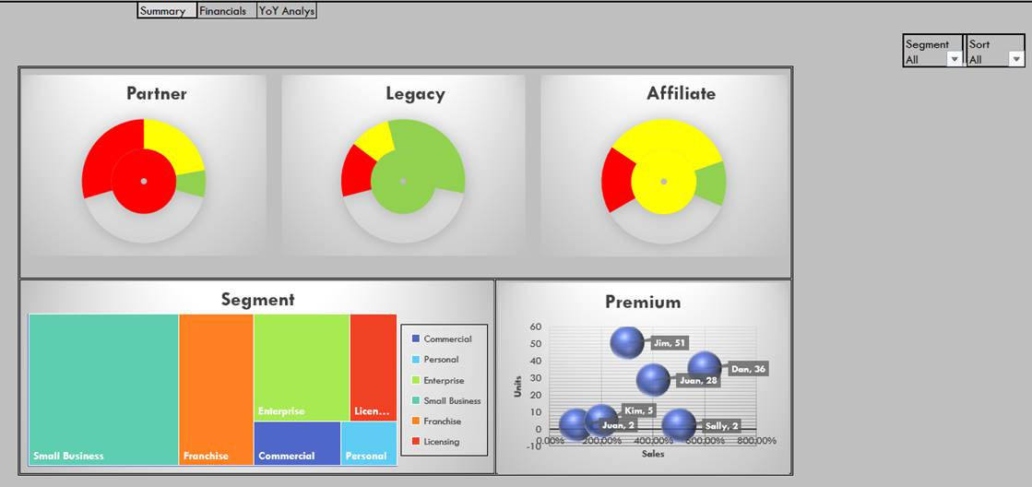
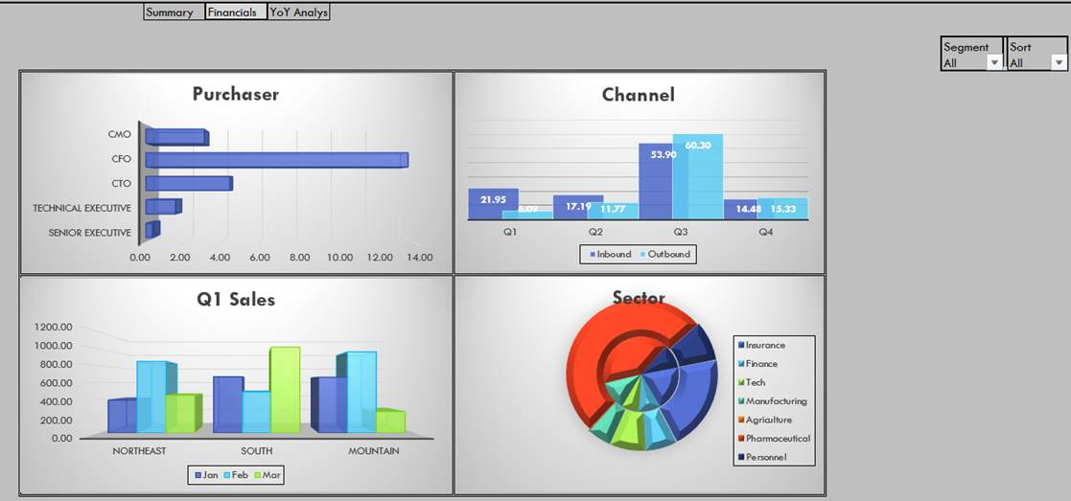
We see reports everyday that all have the same problem
What is Story Telling with Data
Notes:
Hard to tell the story with some visuals because there is so much going on in the page.
No story, so the visual does not stick
3 D Layering and Drop shadows - Eye sore
Color scheme, fonts, end up making you look like you are from 1990s
Use of incorrect charts
Instructor: good to mention we doctored these up to share some of the bad examples we come across in the real world.
(Image Source: Slalom under contract with Microsoft)

Slide 8
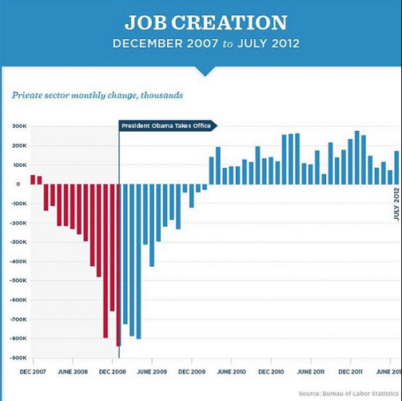
What is Story Telling with Data
For a visual to work, they need to tell the story the author intended.
Source: Bureau of Labor Statistics | Nathan Yau
Notes:
Are there visuals and reports that tell a great story?
We need to see charts that are clean that tell a story well.
What are some of the things that pop out on this visual? What do the colors represent to you? Does it paint a picture, regardless of if you agree with it or not? Do you see a clear trend line, do you see an impact?
(Image Source: http://michiganjournal.org/wp-content/uploads/2012/04/obama-job-employment.jpg)

Slide 9
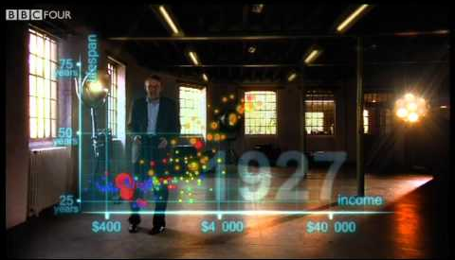
What is Story Telling with Data
Image Source: http://img.youtube.com/vi/jbkSRLYSojo/0.jpg
Source: The Gap minder foundation, BBC, Youtube.com
Notes:
Are there other ways to tell a great story with data?
What really stood out visually? What did Hans do well to tell his story?
Image Source: http://img.youtube.com/vi/jbkSRLYSojo/0.jpg

Slide 10
The Science Behind Data visualization

Slide 11
Science Behind Data Visualization
No context
Excessive precision
Incorrect measures
Incorrectly chosen graph
Clutter
Inaccurate encoding of data
Poor layout
No or poor highlighting
Unnecessary pictures
Bad use of colors
Notes:
Most Bad or forgettable reports all have the same problems
Let’s pick on what I like to call LOUD charts.
The chart doesn’t really tell the story, the chart isn’t the right chart for the story. Colors have no semantic value to them
(Image Source: Slalom under contract with Microsoft)

Slide 12
Science Behind Data Visualization
Notes:
You will learn to identify and fix each of these problems!!
We will learn to spot these and fix them moving forward!
(Image Source: Slalom under contract with Microsoft)

Slide 13

Science Behind Data Visualization
Visual memory system takes up 70% of all sensors in brain
Notes:
To build great visualizations you have to understand Cognitive science
Our Brains – that big red thing in the middle. We have learned to be very visual beings. We have three levels of memory to make things actual.
Iconic Memory
Short Term Memory
Long Term Memory

Slide 14
Science Behind Data Visualization
Iconic memory
Short Term memory
Long Term
Memory
Notes:
Information has to pass from the Iconic Memory->into the Short Term Memory-> and finally if it makes the cut, into the Long Term Memory. Iconic memory involves the memory of visual stimuli. It is how the brain remembers an image you have seen in the world around you. For example, look at an object in the room you are in now, and then close your eyes and visualize that object. The image you "see" in your mind is your iconic memory of that visual stimuli.
(Memory Funnel concept: Slalom under contract with Microsoft)

Slide 15
Iconic Memory
Iconic memory
Short Term memory
Long Term
Memory
Large volume
Short duration
99% of information discarded
Only “interesting data” is passed to Short Term Memory
Notes:
Iconic memory is like a sieve under a faucet. Everything passes through unless it is worthy enough to stick – refer to the slide for the additional talking points
There are two strategies to make the iconic memory work (next slide)

Slide 16
Spark the Iconic Memory – Mute the background noise
Iconic Memory
Things that can distract
Too much color
Overused elements
Grid lines
Too much precision
No highlights
Notes:
Mute the background noise – remove all distractions
Highlight key items – No highlights are bad.
(Image Source: Slalom under contract with Microsoft)

Slide 17
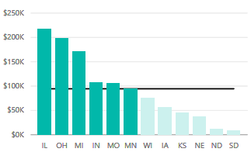
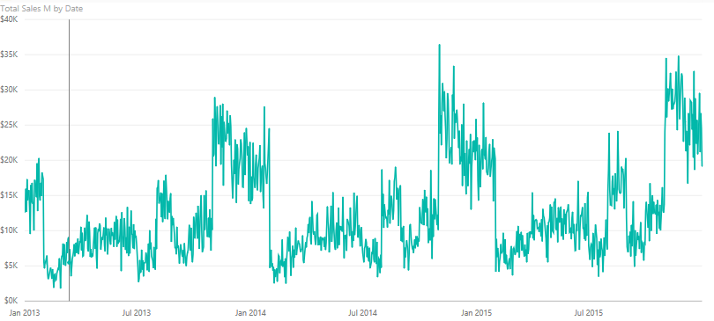
Spark the Iconic memory – Precognitive attributes
Based upon Stephen Few: “Information Dashboard Design”
Notes:
Talk about what Pre-cognitive attributes mean
- Attributes that you recognize without paying thought to and interpret “intuitively”
Talk about how some of these attributes have quantitative encoding and how some do not
Tell that this is based on work done by Stephen Few
Very Precise Quantitative Perception: Length and 2D Positioning
(Image Source: Slalom under contract with Microsoft)

Slide 18
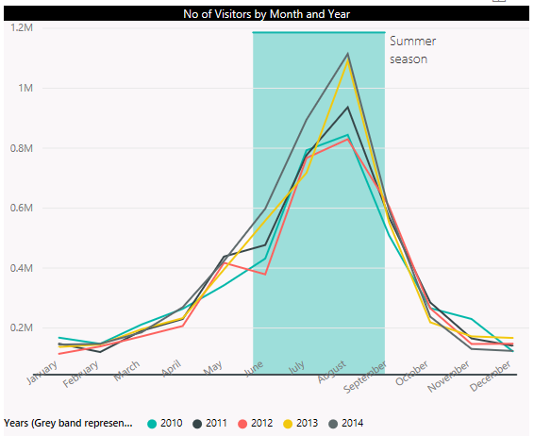
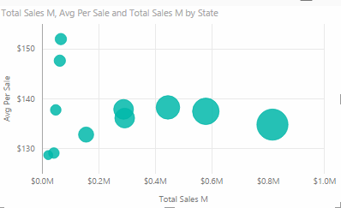

Spark the Iconic memory – Precognitive attributes
Based upon Stephen Few: “Information Dashboard Design”
Notes:
Not Very Precise Quantitative Perception: Width, Size, Intensity, Blur
(Image Source: Slalom under contract with Microsoft)

Slide 19
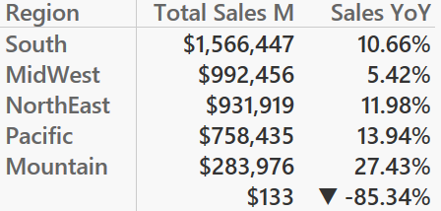
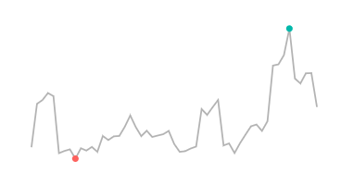
Spark the Iconic memory – Precognitive attributes
Based upon Stephen Few: “Information Dashboard Design”
Notes:
No Quantitative Perception = Orientation, Shape, Enclosure, Added Marks
(Image Source: Slalom under contract with Microsoft)

Slide 20
Short Term Memory
Iconic memory
Short Term memory
Long Term
Memory
Lasts only a few seconds
3 to 5 data points
Data tied together into patterns
Without a pattern (story) will not pass to Long Term Memory
Notes:
How do you make short term memory work to your advantage
Not have more than 3-5 pieces of information
But practically our slides and reports will be complex and have more than 3-5 pieces of information
How do you bring down information to 3-5 pieces
Strategy is to group stuff

Slide 21
Proximity & Similarity
Gestalt’s principles
Based upon Gestalt’s Principles
Notes:
Gestalt’s principles will be employed to strategically Group Items and/or Create Patterns.
Lines together and proximity to each other show a pattern and then the bolding and lightning also draw attention.
You can also have continuity in a triple chart like the three charts stacked on top of each other in Power BI to help you see where there is pattern an differences.
Ask for class participation – who saw the faces first, who saw the vase first?
No Demo yet.
(Image Source: Slalom under contract with Microsoft)

Slide 22
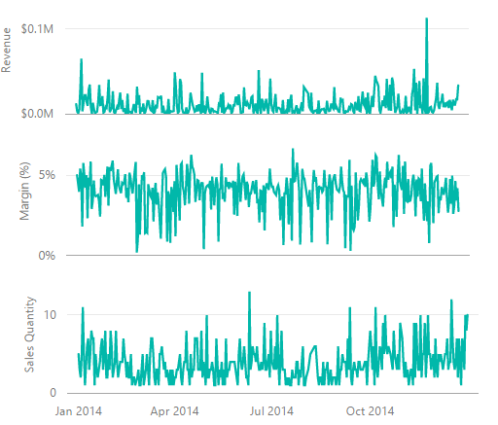
Continuity
Gestalt’s principles
Based upon Gestalt’s Principles
Notes:
Gestalt’s principles will be employed to strategically Group Items and/or Create Patterns.
Lines together and proximity to each other show a pattern and then the bolding and lightning also draw attention.
You can also have continuity in a triple chart like the three charts stacked on top of each other in Power BI to help you see where there is pattern an differences.
Ask for class participation – who saw the faces first, who saw the vase first?
No Demo yet.
(Image Source: Slalom under contract with Microsoft)

Slide 23
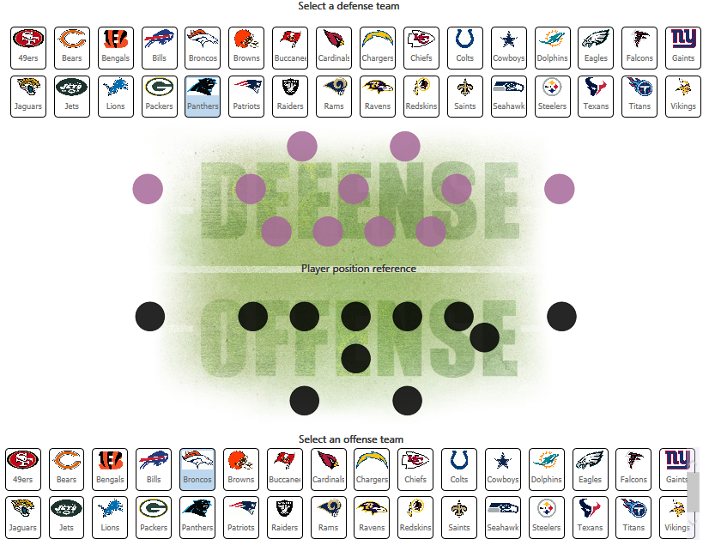
Figure & Ground
Gestalt’s principles
Based upon Gestalt’s Principles
Notes:
Gestalt’s principles will be employed to strategically Group Items and/or Create Patterns.
Lines together and proximity to each other show a pattern and then the bolding and lightning also draw attention.
You can also have continuity in a triple chart like the three charts stacked on top of each other in Power BI to help you see where there is pattern an differences.
Ask for class participation – who saw the faces first, who saw the vase first?
No Demo yet.
(Image Source: Slalom under contract with Microsoft)

Slide 24
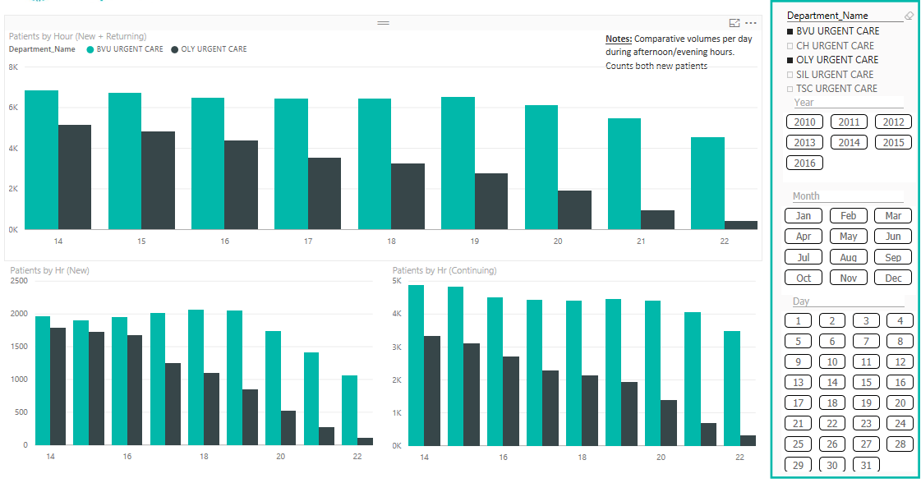
Enclosure & Symmetry
Gestalt’s principles
Based upon Gestalt’s Principles
Notes:
Gestalt’s principles will be employed to strategically Group Items and/or Create Patterns.
Lines together and proximity to each other show a pattern and then the bolding and lightning also draw attention.
You can also have continuity in a triple chart like the three charts stacked on top of each other in Power BI to help you see where there is pattern an differences.
Ask for class participation – who saw the faces first, who saw the vase first?
No Demo yet.
(Image Source: Slalom under contract with Microsoft)

Slide 25
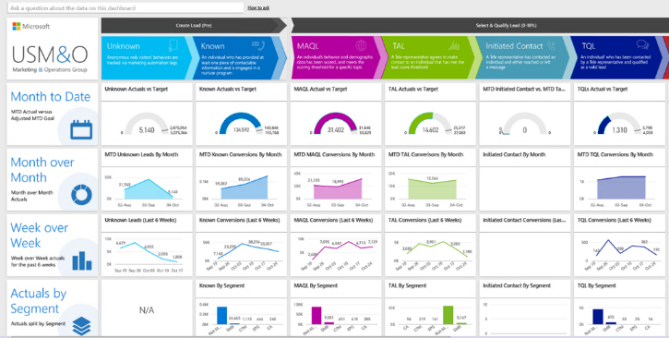
Gestalt’s principles
Based upon Gestalt’s Principles
Notes:
Gestalt’s principles will be employed to strategically Group Items and/or Create Patterns.
Lines together and proximity to each other show a pattern and then the bolding and lightning also draw attention.
You can also have continuity in a triple chart like the three charts stacked on top of each other in Power BI to help you see where there is pattern an differences.
Ask for class participation – who saw the faces first, who saw the vase first?
No Demo yet.
(Image Source: Slalom under contract with Microsoft)

Slide 26
Long Term Memory
Iconic memory
Short Term memory
Long Term
Memory
Long lasting
Data needs to be in Long Term Memory to induce decision making
Notes:
Creating those patterns will help spark the iconic memory, pass it down to the short term memory, and eventually down to the Long Term memory. This can only take a few second-minutes to get to Long Term memory but we have to be in long term memory for effective decision making to take place.

Slide 27
Sparking Long Term Memory
Long Term Memory
Have a clear call for action
Use Pre-cognitive Techniques Spark Interest
Use Gestalt’s principles Data Pattern
Connect dots using Text/Audio to tell a story
Notes:
To spark long term memory you need to combine all the techniques listed above

Slide 28
The Process Behind Data Visualization

Slide 29
Data Structure & Data Grain
Learn about your audience needs
Top 5-7 Questions
Rapid
Prototype
Use Whiteboard or Storyboard to plan POC
Who? Where?
What? How Many?
When? Why?
User Feedback
Build visuals in tool
Start Visuals with Sample Data
User Feedback
Think Agile!!
Notes:
Top Questions and YOUR STORY
This should be a whiteboard type exercise.
Have your data available handy if possible to even see if the visuals you want to come up with are possible and tell the right story. This process used to take a long time but with the technology of today, it can become a much faster way to prototype by working agile.
First learn your audiences needs (top 5 can be top 3-7) but what are the top questions that need to be answered. Do you need to know how many tickets are in red status, do you need to know how many customers are staying engaged and what type of social media are they using and for how long.
Get your top 5 questions and then find out what data you need to have to get these answered. Who has it, who do I need to get it from, can I get it today.
While I still have my stake holders in the room, use the whiteboard to scribble out the concept. What types of visuals like a tree map or a stacked column chart. Then take pictures of the white board and then when you get the first set of sample data into power bi, then start to create the visuals, Get back to your stake holders and show them the new visuals, with Power BI you can make changes right away.
And then as soon as you have your first initial pass at this is usually when you get access to your end data. Power BI is great at being able to map to the new data so you don’t have to break the visuals you created.
(Image Source: Slalom under contract with Microsoft)

Slide 30
Convert the Story to a Data Model
What are you Measuring?
How are you describing or Slicing?
List your big questions:
What is my Total Sales for a Selected Year and Region?
How is my Total Sales doing Year Over Year?
How are my Units trending for various States in my region?
How is my Sales doing by Channel, Device, Category for selected Year?
Which categories are performing best to worst by Total Sales ?
Units
Total Sales
Gross Profit
By Time (Year, Month)
By Geography (Region, State or City)
By Campaign (Channel or Device)
These are Measures which live in Fact tables
These are Attributes that live in Dimension tables
Notes:
Top Questions and YOUR STORY
Have students take notes or jot down THEIR top question
Have them parse out their MEASURES
Have them call out their Attributes
(Image Source: Slalom under contract with Microsoft)

Slide 31
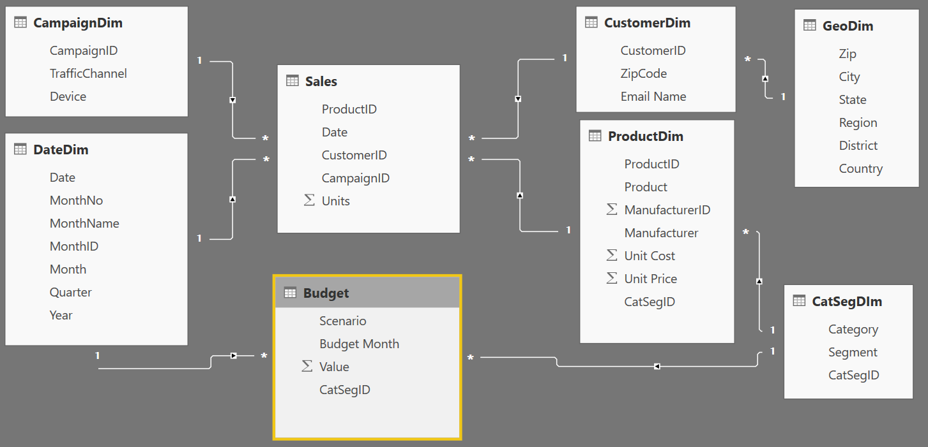
Convert Story to Data Model
Dim
Fact
Dim
Dim
Measures (e.g. Units or Sales) live on Fact tables
Descriptive attributes (e.g. Campaign, Customer name) live on Dimension tables
Relationships tie the data together so you can slice your measures by your attributes
Relationship
Relationship
Notes:
This is an Example of a possible diagram with two facts and multiple dimensins
Keep in mind, your measures (calculations) should be placed on a fact table, but it really does not matter which one. The key is that measures should not be placed on dimension tables. If students want more detail on Why, send them to the DAX class for more detailed discussion.

Slide 32
Dashboards and Reports

Slide 33
Terminology & Definitions
A Power BI dashboard is a single page, often called a canvas, that uses visualizations to tell a story. Because it is limited to one page, a well-designed dashboard contains only the most-important elements of that story.
A Power BI report is a multi-perspective view into a dataset, with visualizations that represent different findings and insights from that dataset. A report can have a single visualization or pages full of visualizations.
Workspaces are containers for dashboards, reports, workbooks, and datasets in Power BI. There are two types of workspaces: *My workspace and app (group) workspaces.
Notes:
Source: Docs.Microsoft.com

Slide 34
Data Sets, Reports, Dashboards (in Service)
Executive
Dashboard
No Dashboard Report is directly shared with users
Summary Dashboard
Project Orion
Dashboard
Project Draco
Dashboard
Project Pisces
Dashboard
Published from PBIX
Subscription Report
Web Report
Audit Report
Telemetry Report
Project Orion Report
Project Draco Report
Project Pisces
Report
Subs.
Data
Set
Web Data Set
Telemetry Data
Set
Orion
Data
Set
Draco
Data
Set
Pisces
Data
Set
Example 1
Example 2
Example 3
Data sets contain the Data Model with tables (created by Power Queries) with relationships and DAX calculations.
The same Data set can be used to build multiple reports
A report can only be built from 1 data set
A Dashboard can be built from multiple reports and/or multiple dashboards
Notes:
Example #1 is the most simple of the examples. One Dataset and One Report. Report could be “Pinned as Live Page” to create the dashboard.
Example #2 – the second report now can also be created as a PBIX using a connection to the data set in PowerBI.com
Example #3 – very common multi-tier dashboard where the executive dashboard is a summary of the project dashboards

Slide 35

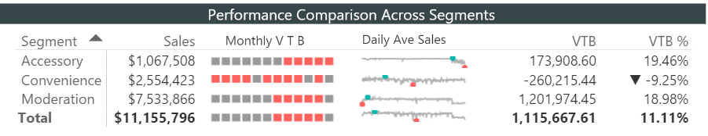
Layouts: Dashboard vs Report
Dashboard Layout
Report Layout
Typically provides snapshot of Business overview and may contain data from multiple reports
Typically answers 1 Business Question
Notes:
Discuss the difference between a Dashboard (Summary level) and a Report (Detail Analysis).
Don’t demo the report at this time – new slide later to break up and demo the report

Slide 36
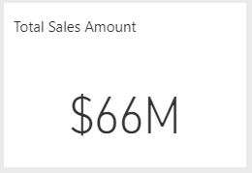
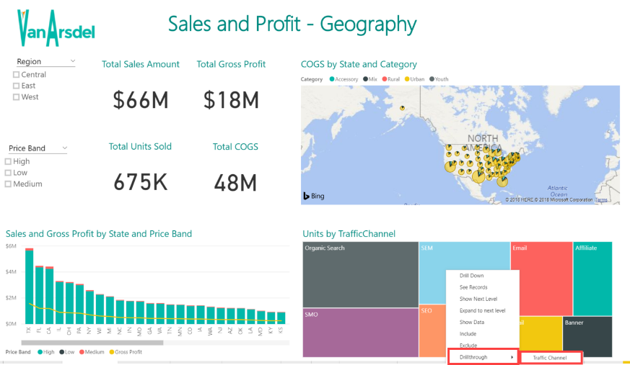
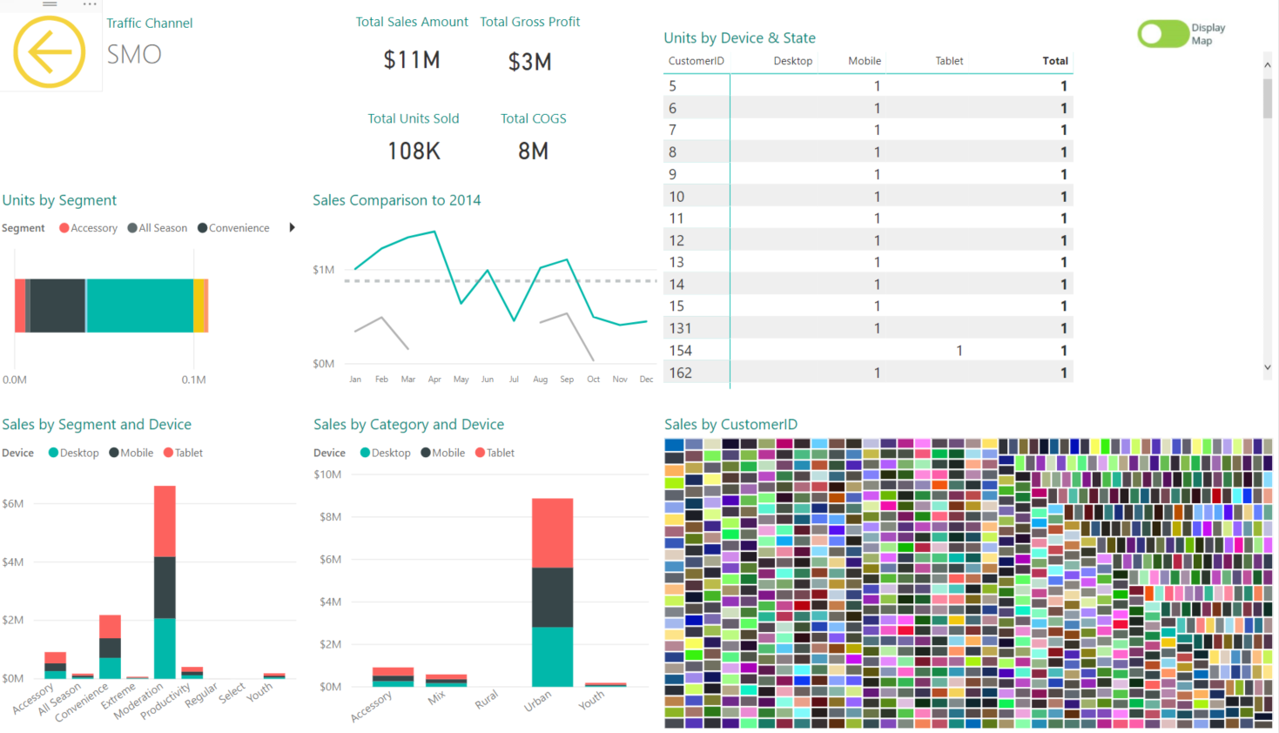
Dashboard to Report Transitions
Dashboard Tile (single KPI) Action Oriented – click thru to report
Report – tell Top level story of KPI
* Drill to another Report (Sliced to Specific details)
In Report can use “Back” to navigate back up

Slide 37
Layouts
Most people’s attention drawn here
2nd most important area
Most people’s attention drawn here
3rd most important area
Least important area
Notes:
Our focus will be cultures which read Left to Right and Top to Bottom. Discuss that other cultures may have different biases.

Slide 38
Dashboards
- Layout & Structure

Slide 39
Dashboard Layouts – Column Layout
Title
Area 1
Title
Area 2
Title
Area 3
This layout is most powerful for Executive Dashboard
Line up each column for 1 area that an Exec manages (in decreasing order of importance)
Ex. Marketing, Finance, Sales
1st KPI
Area 1
1st KPI
Area 2
1st KPI
Area 3
2nd KPI
Area 1
2nd KPI
Area 2
2nd KPI
Area 3
Chart
Area 1
Chart
Area 2
Chart
Area 3

Slide 40
Dashboard Layouts – Vertical Matrix Layout
Layout is useful when
Each row has a story
Each column has similar KPIs
Usually helpful in Marketing, Supply Chain (think conversion funnels etc.)
Notes:
They have used color in a really effective way here. The only reason that the gauge charts are the same color is that this particular tile cannot change color at this time.
The use of colors as we talked about in previous slides help show the continuity for each stage of the Sales process while each row shows the comparable data.

Slide 41
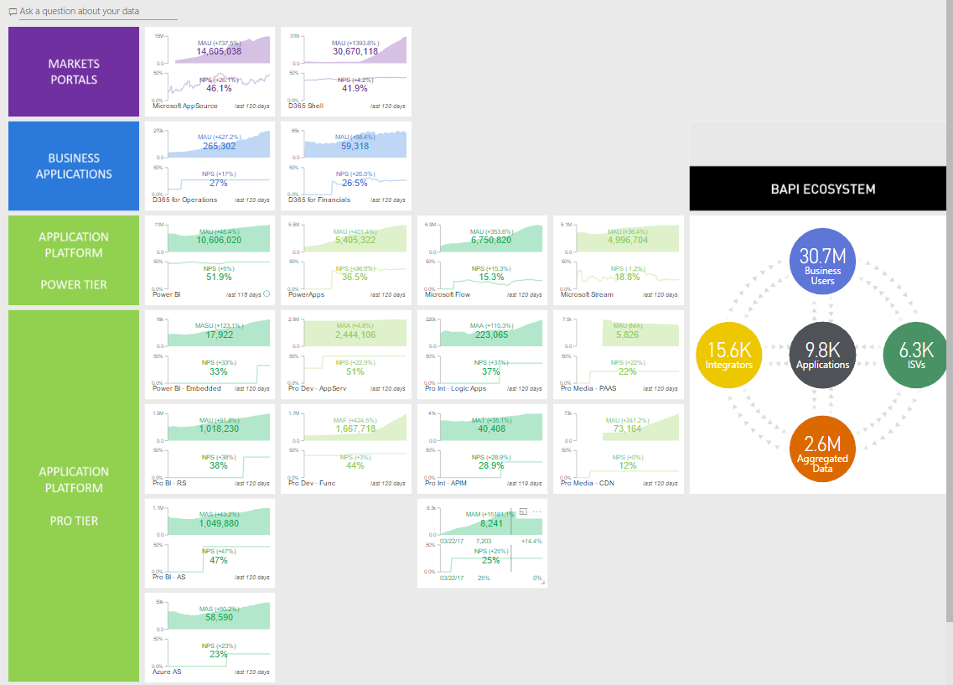
Dashboard Layouts – Horizontal Matrix
This Dashboard is currently in use by Microsoft to manage their cloud business.
https://powerbi.microsoft.com/en-us/blog/how-microsoft-uses-power-bi-to-run-its-growing-cloud-business/
Notes:
Explain this a real Microsoft example from the lead of BI and Analytics for James Phillips
The article was published in April 2017 by Slawomir Kierner
https://powerbi.microsoft.com/en-us/blog/how-microsoft-uses-power-bi-to-run-its-growing-cloud-business/
Another really good example of a dashboard where color is used to group appropriately. We see two of Gestault’s principles in play here… Closure and Continuity. Closure is by the colors framing the metrics and Continuity is with the spacing between each of the tiles.
(Image Source: Microsoft used with permission)

Slide 42
Chart Selection

Slide 43
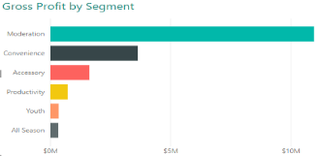
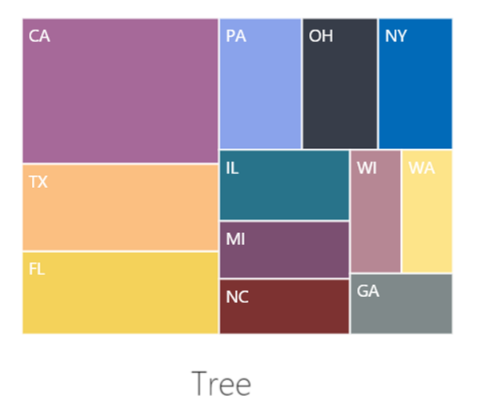
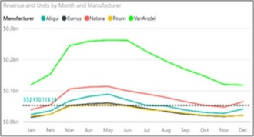
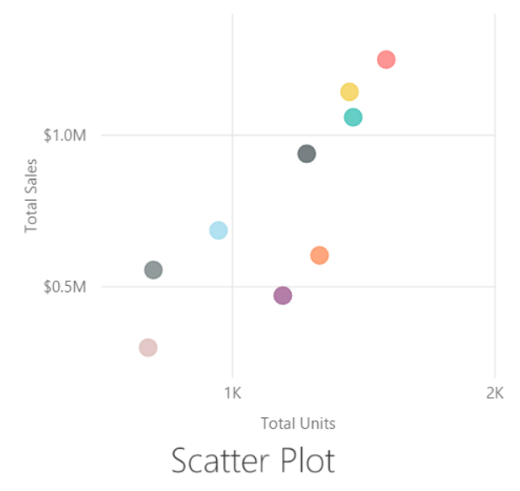
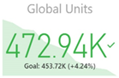
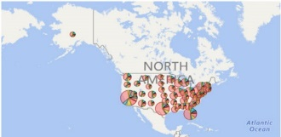
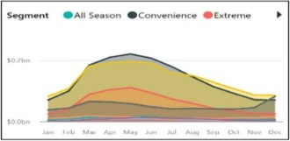
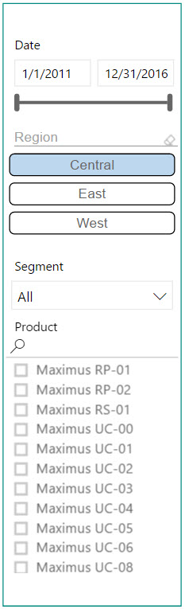
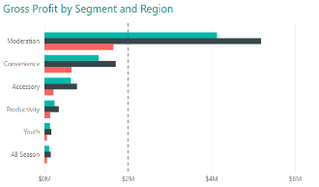
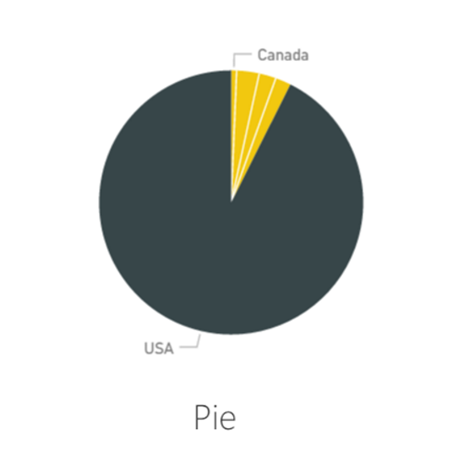
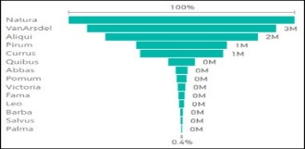
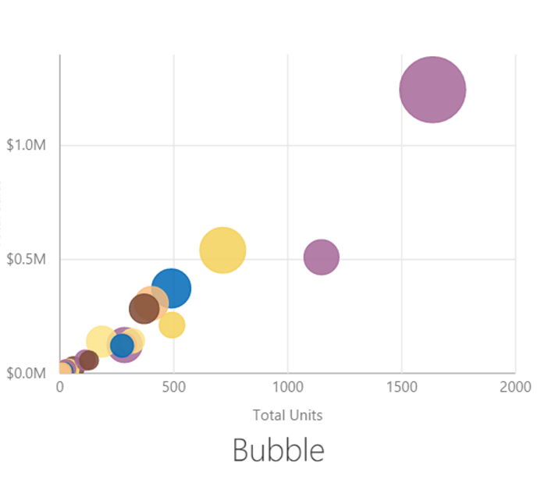
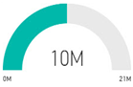
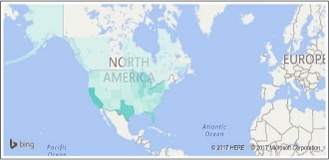
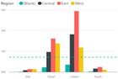
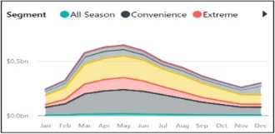
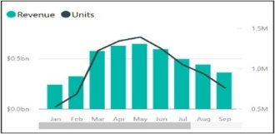
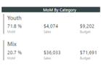
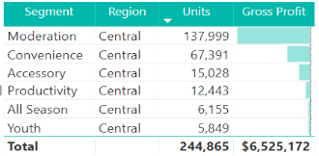
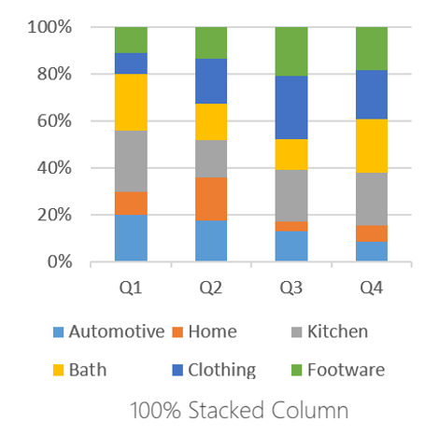
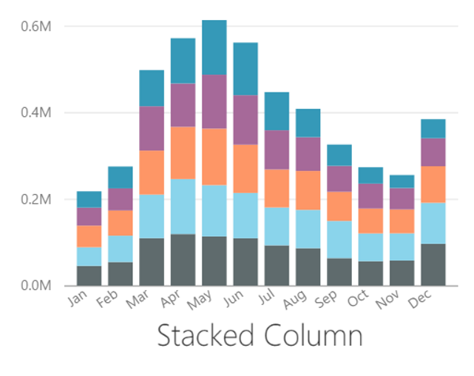
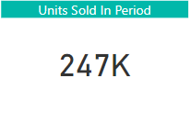
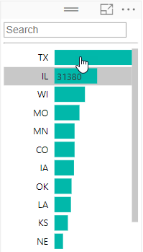
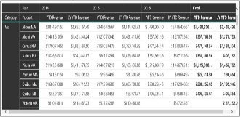
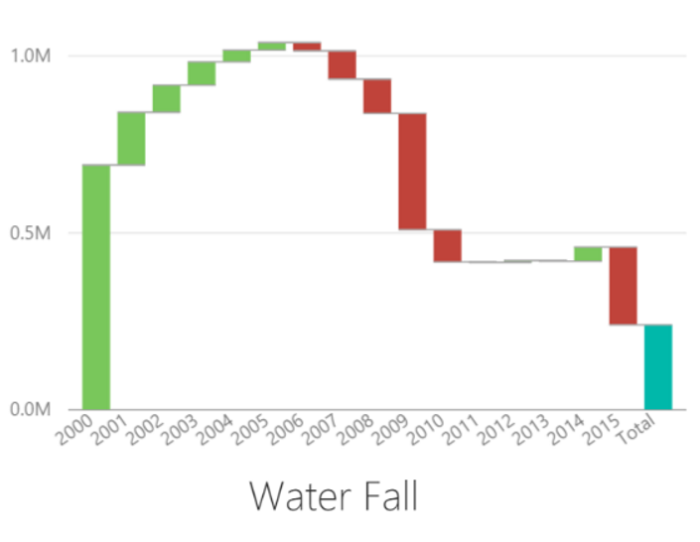
Choosing the Right Charts for the Right Purpose
Comparison
Composition
Trend
Distribution
Status
Geographic
Relationships
Slicing/Filtering
Stacked Bar
Tree
Line
Scatter Plot
KPI
Map
Area
Clustered Bar
Pie
Funnel
Bubble
Gauge
Filled Map
Bubble
Clustered Column
Stacked Area
Line and Stacked Column
Map
Multi-row Card
Table
100% Stacked Column
Stacked Column
Card
Matrix
Water Fall
Notes:
Demo- go through some scenarios and when to use.
(Image Source: Slalom under contract with Microsoft)

Slide 44
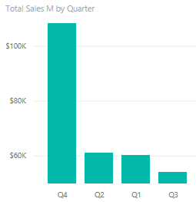
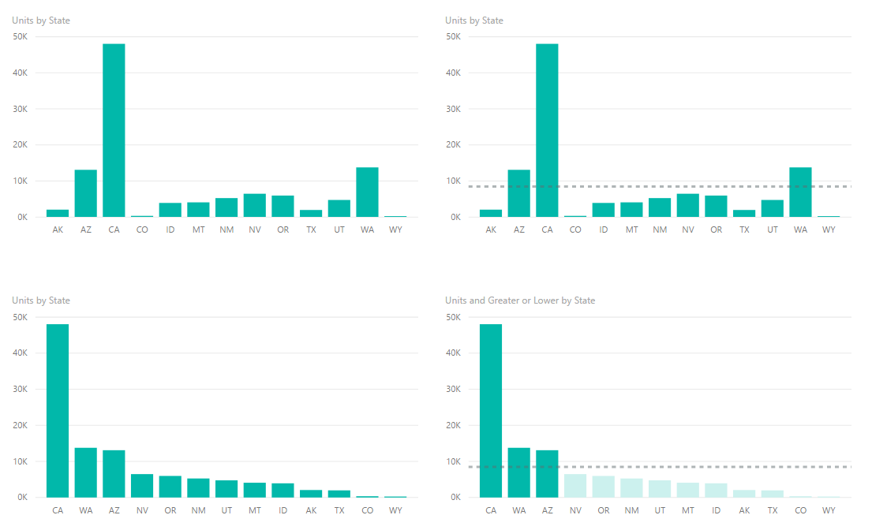

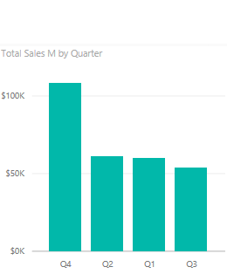

Column charts for Comparison
Start Axis at 0
Sort Chart
Try to Have a Reference Line
Use colors to draw attention
Notes:
Discuss the implications of each choice

Slide 45
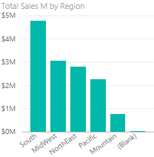
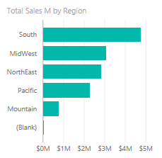
Column chart vs Bar Chart for Comparison
When you have too many elements to display in a column, the bar chart can be easier to scroll.
Notes:
Bar charts now have the ability to word wrap the Y axis which makes them even more powerful.

Slide 46


Line Charts
Start Axis based on your “Business scenario”
Choose the right Aspect Ratio
Try to have a Reference Line
Use colors to draw attention strategically
Decide whether to “Show items with no data”
Data can be misleading if the breaks are connected
In the formatting pane, change the axis to categorical from continuous
Notes:
One thing to keep in mind is the aspect ratio. If too short you exaggerate peaks too much, too long and the chart is too flat. Not too many lines or pieces of information otherwise the brain cannot really depict the different lines. If you want to Demo, in the Complete pbix go to the Traffic Channel tab, Toggle the Display Matrix so it shows the matrix and Drill thru on CustomerID 1 to see the No Data Line Chart

Slide 47



Area Chart vs Line Chart
Choose Area Charts sparingly (when # of series < 5)
Too many colors can be distracting
Often Line charts are the better option
Would a Line Chart better portray my meaning?
Is the Area the meaningful thing I am measuring?
Notes:
Maybe a treemap might also be better than an area chart

Slide 48
Stacked Area Charts
Used to show how proportions and totals are changing
Choose this chart wisely
Can lead to misleading conclusions
The eye tends to interpret the trends using the top lines of each shaded region rather than using the area of each region
Notes:
Showing how the burn down of certain goals is a good use of the Stacked Area Chart

Slide 49

One Use Case for Area Charts
To see when a trend goes above or below a reference line
Notes:
Very similar to the burn down chart. This displays how a metric compares to a rolling trend.

Slide 50



Stacked vs Clustered Column (Bar) Chart Types
Shows Totals
Shows Part to whole relationship
Inter-Category Comparison
Intra-Category Comparison
Shows Mix% change
Ignore absolute numbers
Notes:
Really important to be thinking about what the future of the report is? Will new categories be added later?
Know your story. If your overall totals of your data are the important item, then you want the stacked chart. If the breakdown itself is the most important thing, then a clustered chart might be better (but you lose the grand total).
The mixed ignores the absolute numbers. We wouldn’t use this if the East is better than the West because it will not show correctly.

Slide 51


Constructing Effective Tree Maps
Tree map is useful to visualize proportions
Use Drill down to allow navigation to detail
Notes:
Top chart shows the details and then use a drill down when the click into the details. Left most is the biggest and then smaller towards the bottom right corner.
Chart is on “Sales, Units Sold” tab

Slide 52


Constructing Effective Pie charts
Do not have more than 3-5 categories (if you have more then put a slicer and choose a default)
Have data labels
Choose right Sort Order
Choose appropriate colors
Bad Pie chart
Good Pie chart
Notes:
Top pie chart – Yeah…. Way too many categories. How can you differentiate and then the ratios are not in a continuous sort order.
The brain really enjoys the bottom pie chart better if you have to use a Pie Chart.

Slide 53



Constructing Effective Tables
Reduce precision
Use muted background color
Choose the right font size
Use white space for columns instead of borders
Highlight items using Symbols
Sort Table based on Key KPIs
Notes:
Talk about table best practices (no demo for this slide)
No distracting colors, borders, reduce precision
If you are showing numbers in the millions, you don’t need to show pennies
Don’t go crazy with too much formatting in the tile.

Slide 54


Constructing Effective Cards
Category Labels can be renamed per each visual
Choose right precision levels
Use colors to draw attention to KPIs that matter most
Use KPIs in conjunction with Symbols to draw attention

Slide 55




Constructing Effective Slicers
Slicer as List
Date slicer
Enclose Slicers using a subtle box
Group Slicers together and keep them on right side of page
Conserve space by using Dropdown Slicers
Use “Chiclet Slicers” for a different look
When Slicing Dates, use the Date Slicer
Numeric slicer
Chiclet slicer
Chiclet slicer
Slicers as
Dropdown
Notes:
Put all of your slicers together by overlaying a shape box with a clear fill. Usually a 1 point, and depending on your theme colors, maybe a light gray.
Key is to make sure to send it to the back so that all of your slicers are functional.
Chicklet Slicers are custom visuals that can be downloaded from the Custom Visual website.
Date range slicer is a great slicer as well
Brand new – in Home – Files, Options and Settings, Options, Preview Features – turn on Numeric Range Slicer
Drop the CustomerID field onto the canvas, change to Slicer
They cannot be used with Measures – only with numeric columns
In order to set a “default” value, make a selection in the Slicer

Slide 56

Constructing Scatter Charts
Used to see distributions of 2 or more variables
Use Hierarchies
Helps to identify outliers
Useful for categorization or clustering
Time Axis used to show changes over time
Choose colors wisely

Slide 57
Custom Visuals

Slide 58

Import Custom Visual
Power BI Customizations
Click the ellipsis on the Visualization menu
Import from Marketplace
Select the visual to Download
Use the visual
If you decide you don’t like it – delete it
Notes:
Explain that each custom visual has a sample workbooks which you can download in addition to the PBIVIS file. They can use that to understand how to use the visual, then load the visual into the sample workbook and try and recreate something with the data from the sample.

Slide 59

Custom Slicers
Notes:
With all of the choices available in both Standard and Custom slicers, you can find the correct one to fit just about any scenario. For date slicers, you would not need all these redundant slicers, use what works best for the page.

Slide 60
Polishing and Formatting

Slide 61

Pin a Live Report Page as a Dashboard
Useful when you don’t want to be constrained by Grids
All slicers work in Dashboard view
Notes:
Pros and Con’s of pinning a live
Cons
You replicate the entire report which causes confusion
Pro
This is useful since you cannot currently Share a Report

Slide 62

Pin a Live Report Page as a Dashboard Tile
Useful when:
The visual you need is constructed of multiple parts
You want very specific formatting on tile
Manually update the URL to an appropriate URL
Notes:
Show “Dashboard Tile” tab, and show how to change the page size so it is proportional to a Dashboard tile. If you have previously published the file to Power BI, create a Dashboard which incorporates the tile.
Story: On the dashboard, the treemap acts as a live slicer to quickly see the trends for each of the three regions.

Slide 63
Colors
How do you pick a color scheme?
Check with your Marketing team for Color/Style Guides
Use Cynthia Brewer’s Color Brewer or other sites to choose Color Blind friendly colors
Use the Adobe Color Wheel to get custom complementary colors
Paletton.com is the color scheme generator that the Power BI product team uses
Color Blind Sensitive: Contrast Analyzer is a tool you can use that creates a “lens” to see how people with visual disabilities would view your reports: https://developer.paciellogroup.com/resources/contrastanalyser/
Use Power BI’s default color scheme
Pro Tip: Use Pixie or a similar tool to pick colors from Internet and other places
Notes:
Demo these sites
There are some executives who are color blind and when presenting reports, they might be missing part of the story that other people are getting.

Slide 64



Types of Colors
Sequential
Divergent
Qualitative
When you have to imply an increasing or decreasing scale
When there are two divergent set of values with a middle ground
When the values don’t have any logical ordering
Notes:
(Image Source: Slalom under contract with Microsoft)

Slide 65

Things to remember when using colors
Do not have more than 3-5 colors display on a single visual (think of Short Term memory)
The eye cannot differentiate more than 5 colors of same hue
Try to have a semantic meaning for your colors (Red = Bad, Green = Good)
Notes:
The chart on the left hand side looks like a wheel of fortune. It is too cluttered
The chart on the right hand side would be fine if the data was SEQUENTIAL, but it actually is QUALITATIVE, so the colors should be more distinct.
Also you don’t know the environment on which others will be viewing your visuals. In many training classes we host, the colors look great on our screens but through the LCD projector or the room size, the colors get washed out.

Slide 66



Make your own Theme
Theme files are simple JSON files
Import the theme into your PBIX to update styles in your report
Color palette
Font
Visual Formatting (and more…)
Check out pre-made themes in the Power BI Theme Gallery
Blog post on how to apply themes: https://powerbi.microsoft.com/en-us/blog/power-bi-community-report-theme-gallery/
Theme Generator: https://powerbi.tips/tools/report-theme-generator-v3/
Notes:
Discuss the process to use a theme.
App to create Themes: this automatic theme generator
DEMO: Open Contrast Analyzer and then Theme Generator. Creating a Theme Generator lab.

Slide 67
Font
2 Font Types
Serif
Sans-Serif
Monospace
Informal
Serif
Sans-Serif
Monospace
Informal
Sans-Serif fonts most suited for Digital Media in a Professional Setting
Ex. Segoe, Calibri, Trebuchet
Notes:
Serifs are the embellishments at the beginning or end of the stroke of a letter, like the “feet” on the I & F in Serif. A Sans-Serif (without serif) fond does not have these and are better for screens.
Monospace has to due with kerning (the left/right space a letter takes up). In the query editor, you can set the view to display in Monospace mode (all letters take up the same space) which can be helpful when parsing queries
What is the name of the Informal Font? (Comic Sans) When should you use it in a professional setting? (Never) Discuss use of proper formal fonts for Professional Dashboards and Reports

Slide 68
Changing font weight using three techniques
Change font size
Hi Power BI - Segoe UI Light 28
Hi Power BI - Segoe UI Light 24
Choose different font with greater weight from same family
Hi Power BI - Segoe UI (Body) 24
Hi Power BI - Segoe UI Light 24
Bold an existing font
Hi Power BI - Segoe UI Light 24 (Bolded)
Hi Power BI - Segoe UI Light 24 (Non-Bolded)
Try all three techniques to see which one looks the best
Notes:
Stephen Few showed us earlier that the thickness of a line can help spark short term memory so changing font to a thicker weight in the same family can help with emphasis.
Note, that italics are more for emphasis than size.

Slide 69
Font Recommendations
Choose at the most 2-3 font types/sizes on a report page/dashboard
Choose a lighter weight font Ex. “Segoe UI Light” for
Axis
Non important Data Labels
Text box
Non Titles
Use a higher weight font from same family for Titles rather than (bold) Ex. Segoe UI Bold

Slide 70

Use of Fonts
Notes:
Discuss the use of consistent fonts and colors in this report
Continuity in the spacing helps naturally break up the visuals
(Image Source: Slalom under contract with Microsoft)

Slide 71
Icons
Effective use of icons can add to perceptual depth of a report
Don’t over use icons or misuse icons
Notes:
In the picture above notice how the icon with chevrons stretches across multiple tiles. How do you do this?
Note to instructor: No need to actually build the big icon. Just drop hints
Step 1: Create the icons using Power Point
Step 2: For the icon to span across multiple tiles you need to know the right size in terms of pixels. How do you do this. In the next slide I have listed formulas that will help you calculate
(Image Source: Microsoft used with permission)

Slide 72


Dashboard Tile Art
Rectangle image size 1.81” by 2.66”
Add header text
Add subtitle text
Add circle shape for icon emphasis
Add icon from native Office 2016 Icon library
Change color of icon graphic
Snip out the box and save as PNG
Month to Date
MTD Actual vs MTD Goal

Slide 73
Proportional Sizes for Custom Dashboard Tiles
1 x 1 Tile – 266:181 pixels
2 x 1 Tile – 540:181 pixels
3 x 1 Tile – 816:181 pixels
Rule of Thumb Formula:
Images Width = 266 * (Number of Tiles Wide)+ 8 (Number of Tiles Wide – 1)
Image Height = 181 * (Number of Tiles High)+ 8 (Number of Tiles High– 1)
Pro Tip: Tile sizes don’t have to be exact, just proportional (i.e. 2.66” by 1.81”)
Notes:
Don’t worry about absolute pixels – each dashboard tile just needs to be proportional to the above.

Slide 74


Symbols
⇙
▼
⚠
➕
✔
⚐
★
◕
Different Ways to Use Symbols
Unicode Symbols - You can find Unicode symbols at Unicode-table.com or Unicode.org (need to convert hex to dec) (rendered in Black/White)
Locate the web page for the desired symbol
Scroll down to see the “Your Browser” section
Highlight the symbol and copy ( Ctrl+C )
Paste ( Ctrl+V ) into the formula bar of your DAX
Notes:
Demo: Cards with MoM% calculation – add a second symbol to the > 0 (May & June 2016 show Neg)
If Unicode-table.com is down. Show the “Long way”: Open “Unicode.org/Charts” > Select Emoticon to see the chart. Open Excel and enter a Hex Code
Use formula =Hex2Dec(cell) to convert to Decimal then go into DAX and use =UNICHAR(128512) – for big smiley face

Slide 75

KPIs
Different Ways to Obtain/Use KPIs
Use the KPI visualization in Power BI Desktop
If you import an Excel data model with KPIs into Power BI Desktop, the KPIs will be maintained and render in color
If you connect Power BI Desktop to either SSAS Multi-Dimensional or Tabular Model which contains KPIs, the KPIs will render in color in your visualizations
In the Table Visual, use conditional formatting to set colors in a column then set the column width very small to only display the colors
Notes:
DEMO: KPI Page – Show changing the Color Coding “High is Good” to “Low is Good”
Show Removing the goal/distance indicators

Slide 76
Conceptual Pieces

Slide 77
Report Layout “Hacks”
Can this be done in Power BI?
Notes:
DEMO: Table with Sparks: Show in the product how all the visuals work together
There are actually multiple charts stacked onto of each other
Click on the matrix chart and move it down the page so it is no longer covering the other charts (students should start to understand the “stack hack”)
Hover your mouse over “VTB” to show how the column is very wide which creates white space
Hover over all of each chart that make up the Monthly VTB visuals to show that there are 6 visuals that make up this column (header and 5 column charts)
Each column chart has a “visual level filter” set to the corresponding segment value of the row in the matrix chart
Explain the VtB negative and VtB positive DAX Measures – and how they are mutually exclusive, and are based on the [VTB] Measure
Show Data Colors for the charts
Explain that you can make one chart, get it completely formatted then copy (CTRL+C) and paste (CTRL+V) to make the rest.
Explain the Daily Ave Sales column
Basically each is a line chart with three measures
Take the chart into “Focus Mode” to highlight that function
Explain the Avg Per Sale, MinPoint & MaxPoint DAX Measures (Explain how VAR sets the overall variable which is used in the RETURN)
Again, Each column chart has a “visual level filter” set to the corresponding segment value of the row in the matrix chart
Don’t forget to put a rectangle object from “Import Shapes” on top as a barrier which disallows sorting (set the line width to zero and turn off fill).

Slide 78


Bar charts as KPIs
You can do the same with Pie Charts
Notes:
Demo: KPIs Page

Slide 79



Spark Lines
Spark line with Min, Max
YoY growth with +/-
Win loss charts
How do you create these with Power BI?
Notes:
Sparklines shown with Original Table (Table with Sparks)
To create the middle graph
Drop a vertical Stacked Bar Chart onto the canvas
Add MonthNo to the Axis
Now, let’s create new measures to use in the graph:
Search for the VTB Negative measure in the Fields list
Highlight and copy the formula from the Formula Bar
Create a new measure titled [VTB Negative$]
Paste the formula in the Formula Bar
Replace 1 with [VTB] and enter
Repeat steps 1 – 5 to create a new VTB Positive$ measure
Add VTB Negative$ and VTB Positive$ as values in the graph
Create a Chiclet Slice for Year
Select 2015 as the year since it contains a negative value
Turn off the X-axis
Turn off the Y-axis
Turn off the Legend
Set data colors

Slide 80


Hyperlinks and Images
Full path of the URL in a field
Modify the Data Category (modeling ribbon)
ImageURL – to see image
WebURL – to see Link Symbol
Supports all link types displayed at left.
How do you create these with Power BI?
Notes:
Demo: Cards Tab – Table with URL
For the Hyperlink, the field WebURL has the Data Category set to “WebURL”
For the Images, the the field Full URL has the Data Category set to “ImageURL”

Slide 81
Final Thoughts

Slide 82
Sample Business Questions for Agile Process
What is my Total Sales for a Selected Year and Region?
How is my Total Sales doing Year Over Year?
How is Gross Profit for various States in my region?
How is my Sales doing by Channel, Device, Category for selected Year?
How is my Total Sales and YoY Growth for the region doing compared to other regions?
What is my Total Sales for selected Year, Month across Categories?
Which categories and performing best to worst by Total Sales ?
How is VTB, YoY, MoM for various categories which ones are doing good and bad?
How is my 12 month VTB trend for my categories?
How is my 1 month Avg Per Sale trend for my categories? What is the Min and Max Avg Per Sale?
Notes:
Individually or in small groups, select 1-2 questions from the question slide. Create the appropriate visuals to tell that story. At the end of your time, have the visual complete and be ready to walk the instructor/class through the creation of your visual so they can follow your steps.
Be prepared to answer:
Why you chose each visual?
How you decided what values/fields to use in the visual?
Why you made your formatting choices for each visual?

Slide 83
Power BI Support Resources
Contact Support
Report Errors, Issues – Support.PowerBI.com
Resources
Community.PowerBI.com – Community Forum
Report Theme Gallery – A showcase for stunning report themes
Data Stories Gallery – Get inspired with Data Stories by other Power BI users
R-Visuals Gallery – Get inspired by others use of R for analyzing their data
Store.office.com – Custom PBI visuals and R visuals you can download and use in your story
Power BI Blog - weekly updates
User Voice for Power BI – Vote on (or submit) your favorite new ideas for Power BI
Issues.PowerBI.Com – log issues with the community
Whitepaper - Creating an Enterprise Class Dashboard Solution with Power BI
Guided Learning Self Service Power BI training
DAX Formula Language – syntax for DAX
DAX Patterns – Great website to learn new patterns for the DAX Language
Power Query Formula Language – syntax for the “Query” language
Paletton.com – a color scheme generator
https://unicode-table.com/en/ – Unicode Character Table
Theme Generator
Contrast Analyzer: a tool that creates a “lens” to show how people with different visual disabilities might see your reports
Instructors:
Notes:
External Support Resources for Microsoft – Hide this slide for the internal version

Slide 84
Questions?
Hobbs
Digital Insights Consultant
jhobbs@valorem.com

